Slide 1
Using Data Science to Understand and Improve Development Results
Danny Walker, Data Analyst

Slide 2
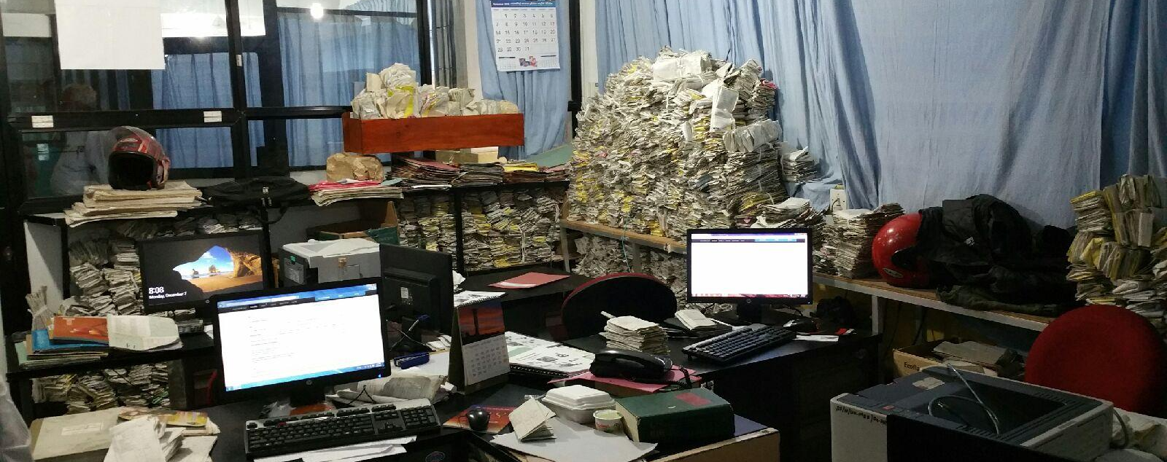
Big Data got you down?

Slide 3
The Data Haystack in Ghana
216 Districts
5521 indicators (MICS, DHS, WDI, and GHO only)
360+ active and completed projects since 2000 (among the largest 10 donors only)
1000+ outputs tracked for active and completed projects
What if we have a simple question about, say, the number of HIV/AIDS trainings (across all organizations)?

Slide 4
Big Picture: Needle in the Haystack
What’s at the core of our “HIV/AIDS trainings” question?
Interdisciplinary interests and investments
Need to make data:
Applicable
Useful
Accessible
Intelligible
Where do we start with so much data?

Slide 5
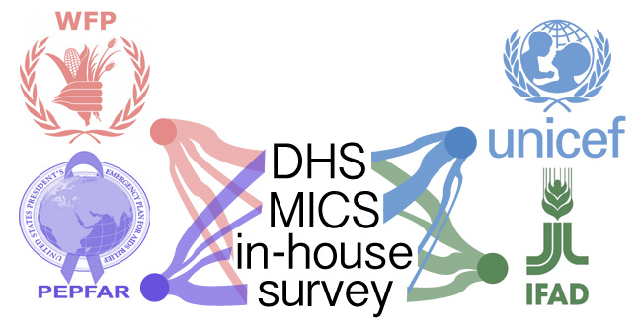
Data Sources
First we need to track the sources of data
Challenges:
Different sampling techniques
Different data storage platforms
Different data formats/ levels of quality
Not enough open data

Slide 6
Data Categorizing
“Infectious diseases”
“HIV/AIDS”
“Maternal health”
Each project is categorized based on keywords and themes
HIV/AIDS & Tuberculosis
Maternal health & Mortality
Family planning & HIV/AIDS

Slide 7
Data Clustering
“1,000 trainings conducted”
“4,000 ARVs distributed”
HIV/AIDS
“10,000 condoms distributed”
“800 trainings conducted
Family planning
“500 children treated”
“1,000 tests conducted”
Trainings
Resources
Treatments
“1,000 HIV/AIDS”
“800 Family planning”
“4,000 ARVs”
“10,000 condoms”
“500 children”
“1,000 tests”

Slide 8
Output Identification
Trainings
World Bank
WHO
Global Fund
DFID
DFATD
WB: Health personnel receiving training (number) (Number, Core) | 5,900.00
WB: Number (#) of health personnel receiving training | 3,853.00
WHO: Health care workers trained in HIV/AIDS management | 480
WHO: Peer educators trained in ART/OI management | 80
Global Fund: Service deliverers trained through SDAs | 104
Service deliverers trained through PMTCT | 140
People trained in home based care of PLWHA | 153
Global Fund: Community-based agents trained | 4039
Health care workers trained in home-based malaria care | 1454
Community agents trained in home-based malaria care | 3828
Global Fund: Health staff trained in malaria management | 11932
Number of service deliverers trained in IPT | 12813
Number of service deliverers trained in correct case management of malaria based on new drug policy | 7637
Number of community based agents trained in correct case management of malaria based on new drug policy | 9465
Global Fund: Counselors trained | 1548
Number of counselors trained in VCT | 1436
Number of service deliverers trained in STI management | 922
Number of service deliverers trained in prophylaxis and treatment of opportunistic infections | 1769
Number of DOT service deliverers trained in HIV counseling | 215
DFID: Volunteers trained | 22063
DFID: Individuals trained- GHS/HCP | 100
Individuals trained- GHS/Teachers | 75
Individuals trained- Peer educators | 400
DFATD: Nurses trained in topics including anthropometric measurements techniques and effective nutrition counselling | 69
Health volunteers trained in topics including anthropometric measurements techniques and effective nutrition counselling | 95
Health promotion assistants trained in topics including anthropometric measurements techniques and effective nutrition counselling | 9
DFATD: Girls trained in Menstrual Hygiene Management | 17321
DFATD: Front-line health workers trained to provide nutrition services | 15751
DFATD: Community-based volunteers trained to conduct two antenatal and three neonatal visits in the first week of a baby's life | 51
Local health professionals trained to support the community-based surveillance volunteers’ referral system | 25
HIV trainings
17,141 total trainings
WB: Health personnel receiving training (number) (Number, Core) | 5,900.00
WB: Number (#) of health personnel receiving training | 3,853.00
WHO: Health care workers trained in HIV/AIDS management | 480
WHO: Peer educators trained in ART/OI management | 80
Service deliverers trained through PMTCT | 140
Global Fund: Community-based agents trained | 4039
Number of counselors trained in VCT | 1436
Number of service deliverers trained in STI management | 922
Number of DOT service deliverers trained in HIV counseling | 215
DFATD: Community-based volunteers trained | 51
Local health professionals trained | 25

Slide 9
Caveats: The Path to Big Data
Open data represents the minority of available data
Better maps of in-country data flow systems
Better geographic components
Synthesis with other project-tracking systems such as IATI and AidData

Slide 10
Full Circle
We’ve found the needle in the haystack—so what?
Applicable and useful to field workers, administrators, etc.
Makes disparate data sources accessible to those that ordinary would not be able to interface with it
Presents data in an intelligible way
Data Science as a bridge between data and interdisciplinary interests and needs
The way forward:
More data!
More interaction with stakeholders to assess data needs

